Slide 1
INT219 CA-2
BASIC IMAGE EDITOR
submitted to:Mrs.Twinkle Chawla
Reg no:11805366
Name:Manukonda Pallavi

Slide 2
Index html part
<!DOCTYPE html>
<html lang="en“>
<head>
<meta charset="UTF-8">
<meta name="viewport" content="width=device-width, initial-scale=1.0">
<link href="css/style.css" rel="stylesheet">
<title>Document</title>
</head>
<body>
<section class="main"> <div class="container"> <div class="main-outer"> <div class="main-left"> <aside> <h3>Image Filters</h3> <form id="slider-form"> <p> <label for="gs">Grayscale</label> <input id="gs" name="gs" type="range" min="" max="100" value="0" class="slider"> </p> <p> <label for="blur">Blur</label> <input id="blur" name="blur" type="range" min="0" max="" value="0" class="slider"> </p> <p> <label for="hue-rotate">Hue-Rotate</label> <input id="hue-rotate" name="hue-rotate" type="range" min="0" max="" value="0" class="slider"> </p> <p> <label for="sepia">Sepia</label> <input id="sepia" name="sepia" type="range" min="0" max="" value="0" class="slider"> </p> <button type="reset" >Reset</button> </form> </aside> </div> <div class="main-right“
> <form id="myform">
<input type="text" placeholder="Image URL" id="onlineurl">
<button type="submit">Change Image</button>
</form>
<div class="img-area">
<img src="images/car.jpg" id="targetimage" alt="">
</div>
</div>
</div>
</div>
</section>
<script src="js/main.js">
</script>
</body>
</html>

Slide 3
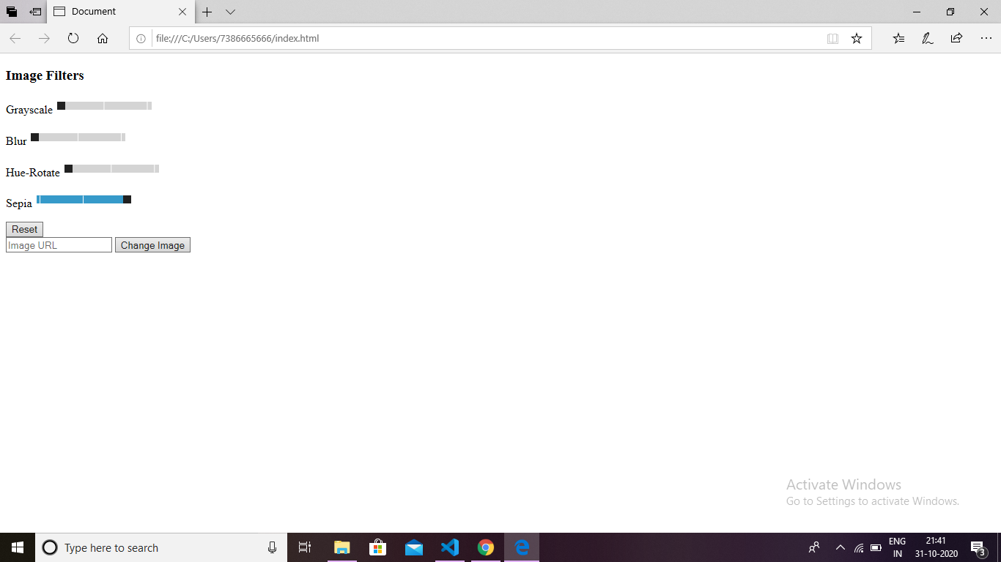

Slide 4
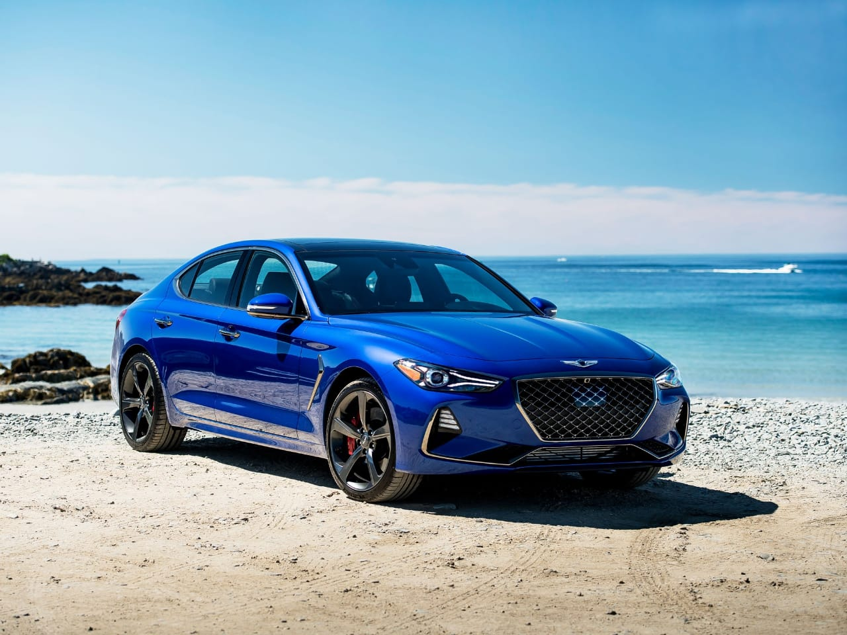

Slide 5
Js part
let myform = document.getElementById('myform');let targetimage = document.getElementById('targetimage');let inputrange = document.querySelectorAll('.slider');myform.addEventListener('submit', function(e){let urlimage = document.getElementById('onlineurl');let urlimageval = urlimage.value; if(urlimageval.length){ targetimage.setAttribute('src',urlimageval); urlimage.value = ''; } e.preventDefault(); console.log('done');};for(let i=0; i<=inputrange.length-1; i++ ){ inputrange[i].addEventListener('input', editimage);}function editimage(){ let gs = document.getElementById('gs'); let blur = document.getElementById('blur'); let huerotate = document.getElementById('hue-rotate'); let sepia = document.getElementById('sepia'); let gsval = gs.value; let blurval = blur.value; let huerotateval = huerotate.value; let sepiaval = sepia.value; targetimage.style.filter = 'grayscale('+gsval+'%) blur('+blurval+'px) hue-rotate('+huerotateval+'deg) sepia('+sepiaval+'%)';} let sliderform = document.getElementById('slider-form');sliderform.addEventListener('reset', function(){ sliderform.reset(); setTimeout(function(){ editimage(); },0) })

Slide 6
Css part
{ margin: 0;padding: 0;box-sizing: border-box; } body {font-family: Arial,Helvetica, sans-serif;overflow-y: hidden;}.main {width: 100%; float: left;}.container { width: 90%;margin: 0 auto;}.main-outer {width: 100%;float: left; padding: 3em;} .main-left {width: 25%;float: left; }.main-left aside {width: 100%;background: #333;height: calc(100vh - 6em);float: left;padding: 40px; }.main-left aside h3 {color: #fff;font-size: 30px;font-weight: normal;margin-bottom: 20px;}.main-left p {margin-bottom: 15px;}.main-left label { color: #fff;display: block;padding-bottom: 10px; }.main-left aside button {float: right; background: #fff;border: none;height: 35px; padding: 0 26px;font-size: 15px;color: #000;cursor: pointer; margin-top: 20px;}.slider { -webkit-appearance: none;width: 100%;height: 15px;border-radius: 5px;background: #d3d3d3;outline: none;opacity: 0.7;-webkit-transition: 0.2s;transition: opacity 0.2s;} .slider::-webkit-slider-thumb {-webkit-appearance: none;appearance: none;width: 25px;height: 25px;border-radius: 50%;background: #4caf50;cursor: pointer;}.slider::-moz-range-thumb { width: 25px; height: 25px;border-radius: 50%;background: #4caf50;cursor: pointer;} .main-right {width: 70%;float: right;}.main-right .img-area {width: 100%;height: 77vh;overflow: hidden;} .main-right .img-area img {width: 100%;} .main-right input[type="text"] {width: 79%;margin-bottom: 20px;height: 45px;padding: 10px;} .main-right button {float: right;background: #333;border: none;height: 45px; padding: 0 26px; font-size: 15px; color: #fff; cursor: pointer; }

Slide 7
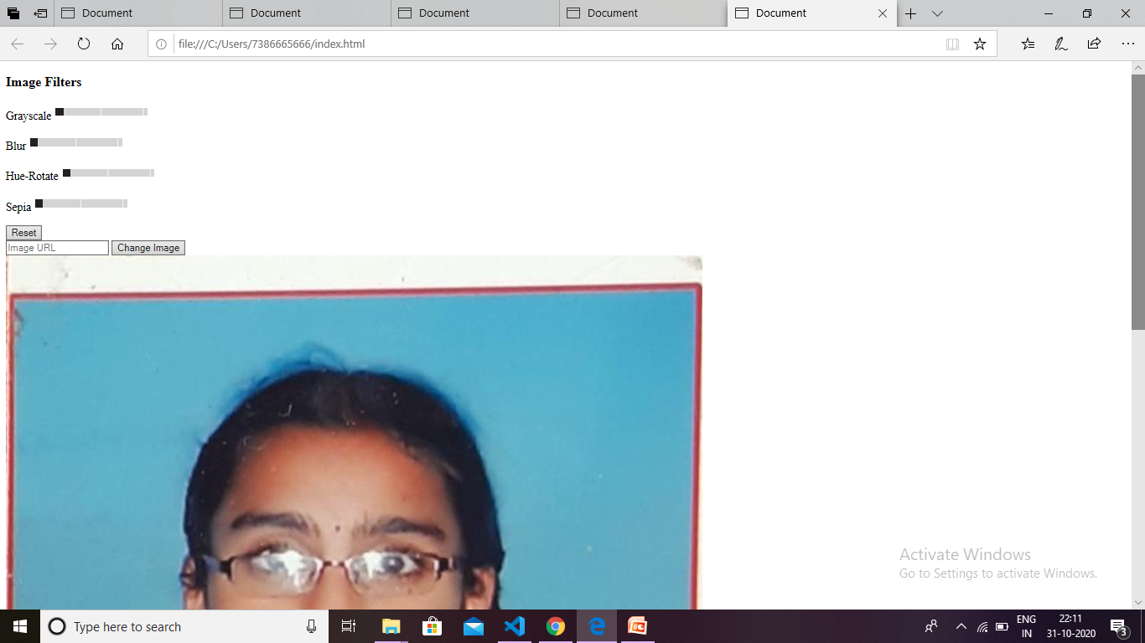
After inserting image

Slide 8
output

Slide 9
Github link
Video link

Slide 10
Resource/reference

